Slide 1

Cab Investment Insights
Raina Singh

Slide 2
Background Information
We want to figure out which of the two companies (Pink Cab or Yellow Cab) should our client invest in
Process:
Make the data usable
Figure out which metrics have a significant impact on returns
Perform statistical analysis techniques
Come to valuable conclusions

Slide 3
About the Data
From 31/01/2016 to 31/12/2018
Total of 359,392 tuples of data
Categories: Transaction ID, Date of Travel, Company, City, KM Traveled, Price Charged, Cost of Trip, Customer ID, Payment Mode, Gender, Age, Income, Population, Users

Slide 4
Profit Analysis
Our Analysis
For simplicity we will only use:
Transaction ID, Date of Travel, Company, City, KM Traveled, Price Charged, Cost of Trip, Customer ID, Payment Mode, Gender, Age, Income, Population, Users

Slide 5
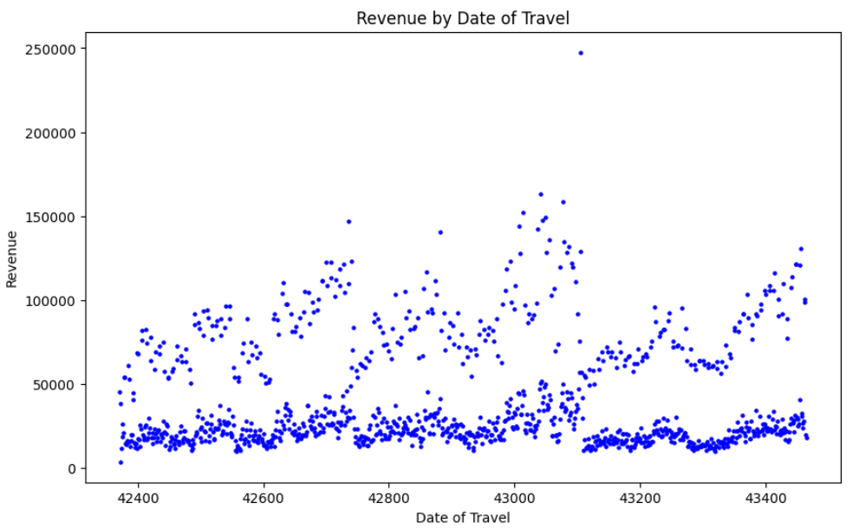
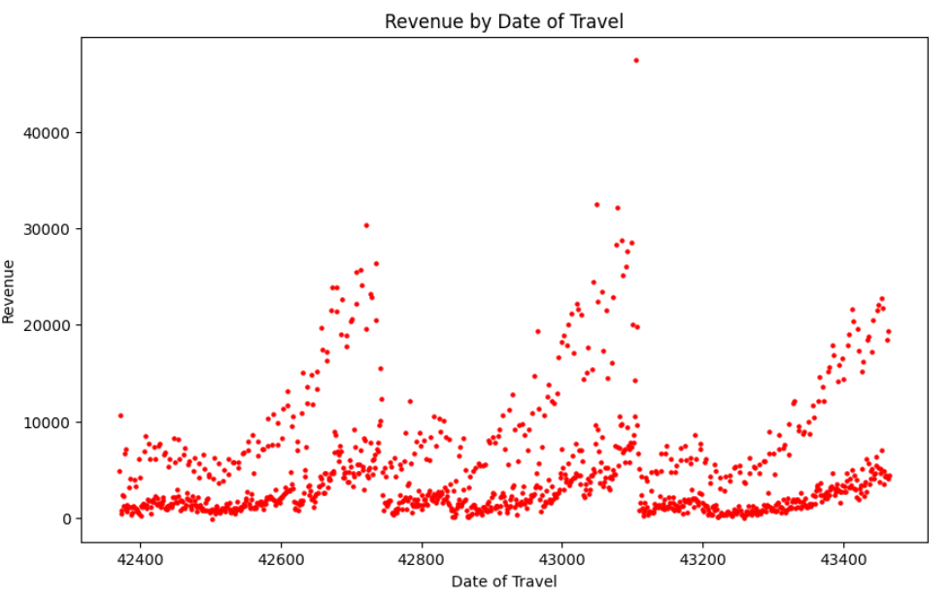

Starting Simple
Although neither of the companies show significant growth, the revenue of Yellow Cab (left) is shifted significantly higher.

Slide 6
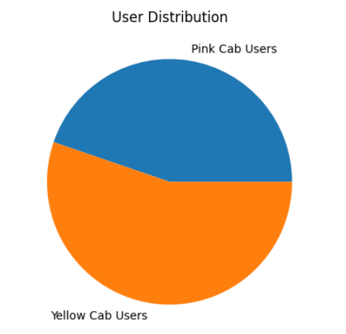

Users
Although not significant, there are a slightly greater number of users for Yellow Cab than there are for Pink Cab.
*Important note: these values can be biased towards city populations

Slide 7
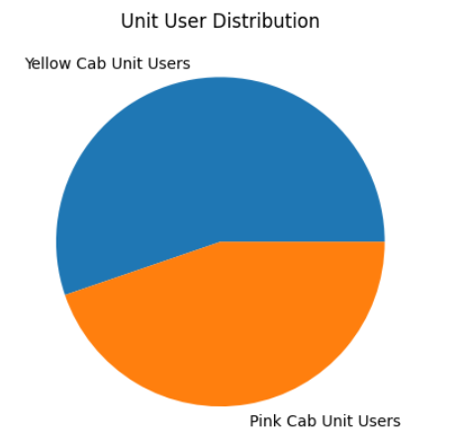

Comparing Users with Population
When we compare the users of both companies with the density of users in each city, we can see that there is still a clear favoring for Yellow Cab

Slide 8
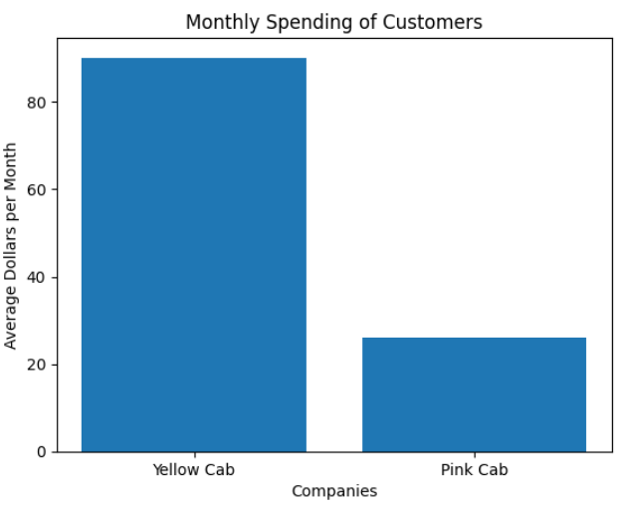
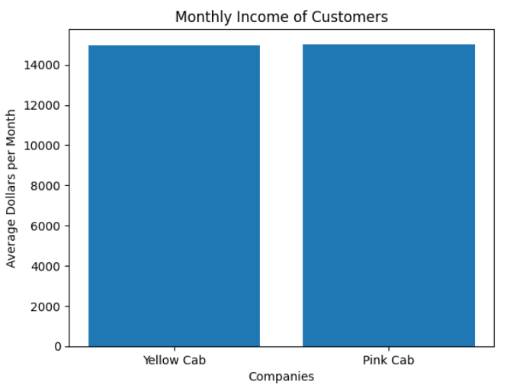
Average Monthly Spending Compared with Income
Average monthly income of users for both companies is around the same. However, Yellow Cab users spend almost four times as much as Pink Cab users on rides, indicating preference for Yellow Cab.

Slide 9
Conclusions of Study
Revenue for both companies is constant (could indicate stability), but Yellow Cab has made significantly more profit than Pink Cab over the time period from which the data is collected
Yellow Cab has more users than Pink Cab, regardless of discrepancies in city populations
Customers tend to spend 4x more on Yellow Cab than Pink Cab regardless of income
Overall suggestion to client: It would be advisable to invest in Yellow Cab due to its revenue stability, greater number of users, and preference from users over Pink Cab

Slide 10
Thank You

